Slide 1
Gender Classification
Using binary neural network
By: Wurud Abid

Slide 2
DataSet
Content
This dataset contains 7 features and a label column.
long_hair
forehead_width_cm
forehead_height_cm
nose_wide
nose_long
lips_thin
distance_nose_to_lip_long
gender

Slide 3
Data discovery

Slide 4
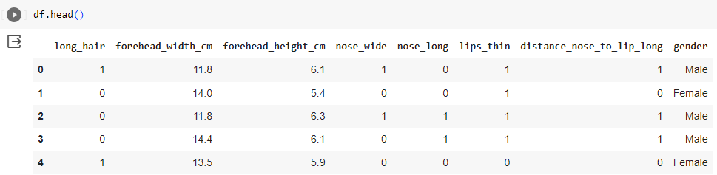
Head()

Slide 5
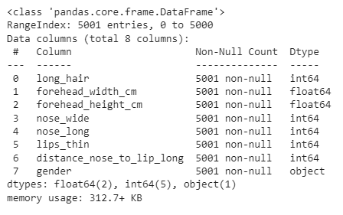
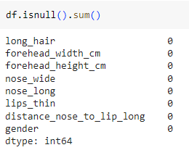
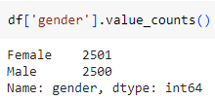
Information of the data
Data information
Null values
Value Count

Slide 6
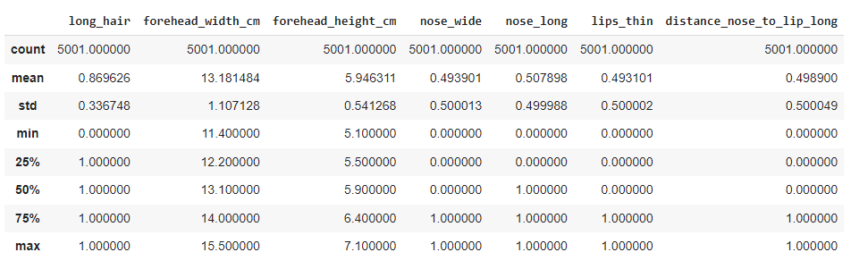
Description of the data

Slide 7
Exploratory Data Analysis

Slide 8
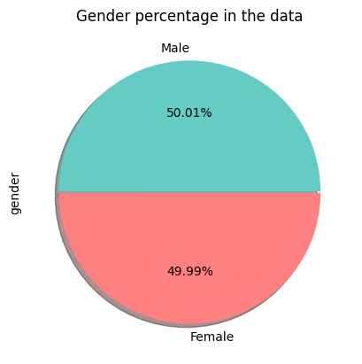
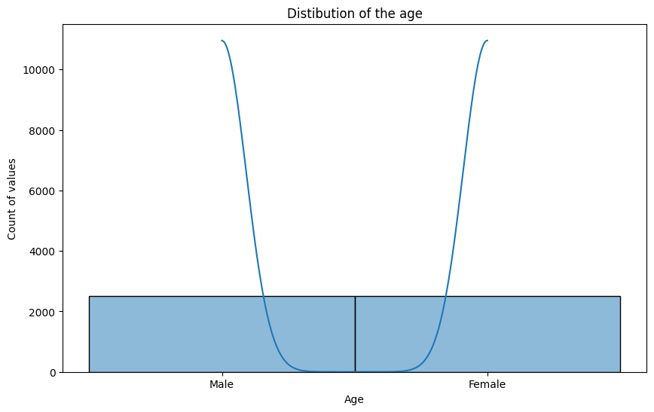
Understanding the gender column

Slide 9
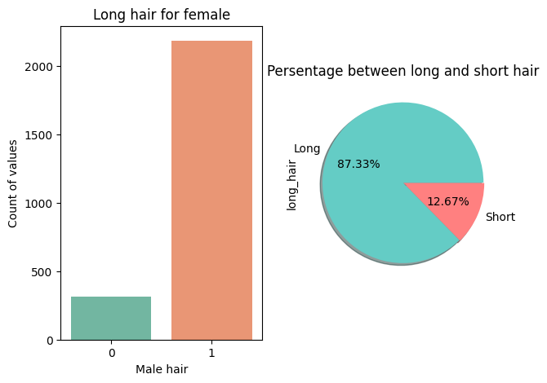
Chart for long hair “female”

Slide 10
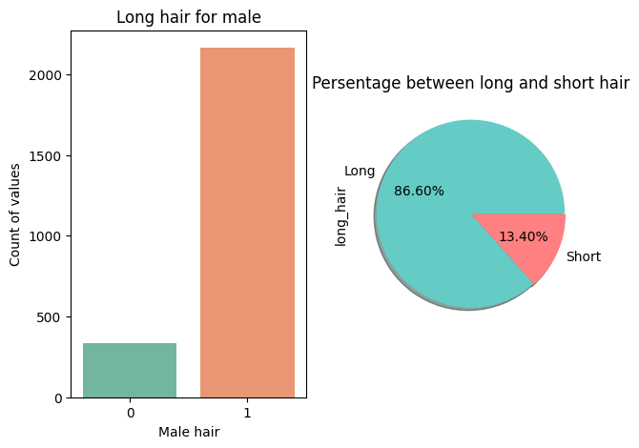
Chart for long hair “MAle”

Slide 11
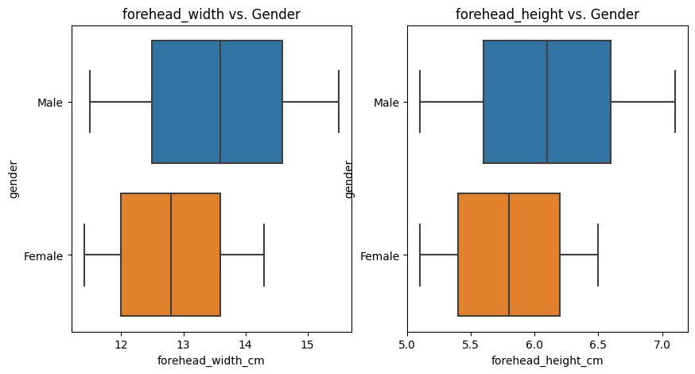
Forehead width and forehead height

Slide 12
Data Cleaning and Processing

Slide 13
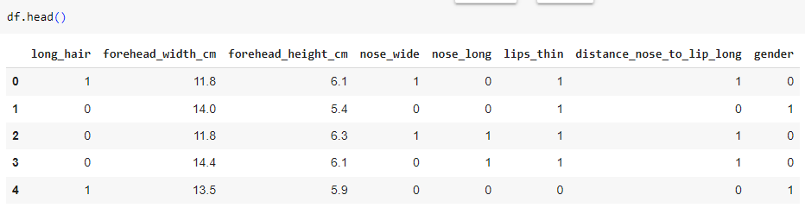
Data conversion
df['gender'] = df['gender'].map({
'Male': 0,
'Female’: 1
})

Slide 14
Trainig / testing

Slide 15
Splitting input and output
# Split the data into X and Y
X = df.drop('gender', axis=1)
y = df['gender’]
# Split the data into training and testing sets
X_train, X_test, y_train, y_test = train_test_split(X, y, test_size=0.2, random_state=42)

Slide 16
Scaling the data
# Standardize the features (mean=0, std=1)
scaler = StandardScaler()
X_train = scaler.fit_transform(X_train)
X_test = scaler.transform(X_test)

Slide 17
Building the model

Slide 18
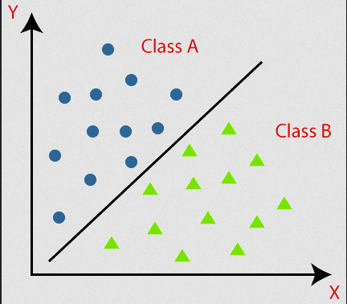
Binary neural network
neural network designed to operate with binary values, typically 0s and 1s. both the model's weights and activations are binarized, reducing memory and computational requirements. During training, the network learns to adjust these weights to make predictions that accurately assign data points to one of the two classes, based on patterns and features extracted from the input data.

Slide 19
Creating the layer
model = keras.Sequential([
keras.layers.Dense(16, activation='relu’, input_shape=(X.shape[1],)),
keras.layers.Dense(16, activation='relu'),
keras.layers.Dense(1, activation='sigmoid’)
# Output layer with sigmoid activation])
# Compile the model
model.compile(optimizer='adam', loss='binary_crossentropy', metrics=['accuracy’])
# Train the model
model.fit(X_train, y_train, epochs=20, batch_size=32, validation_split=0.2)

Slide 20
Accuracy

Slide 21
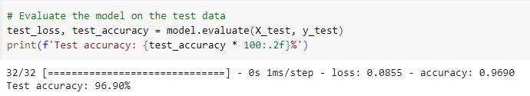
Test loss and accuracy

Slide 22
Confusion Matrix

Slide 23
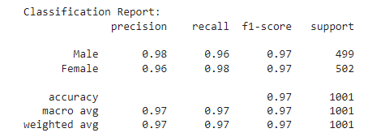
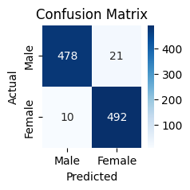
Confusion matrix

